Slide 1
Intro to HTML and HTML5
A.F.M. Mahbubur Rahman
Assistant Professor
Dept. of Computer Science & Engineering
Email : m.r.kushal@gmail.com

Slide 2
Workshop Outline
HTML and XHTML
Cascaded Style Sheet (CSS)
Bootstrap CSS framework
JavaScript Basic
PHP and MySQL

Slide 3
Required Resources
Any XHTML compatible browser
HTML editor (notepad++, Sublime, DreamWeaver)
Apache web server,
PHP scripting language
MySQL database server.

Slide 4
So lets start….

Slide 5
What is WWW?
The World Wide Web (WWW) is most often called the Web.
The Web is a network of computers all over the world.
All the computers in the Web can communicate with each other using HTTP protocol.

Slide 6
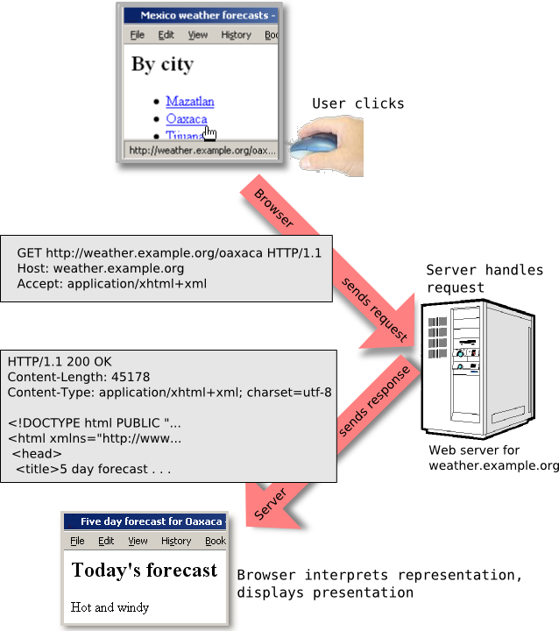
How does the Web Works?

Slide 7
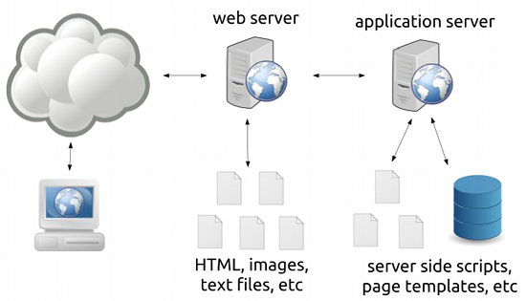
How does the Web Works with Dynamic content
PHP

Slide 8
Content of a Web Page
Sound
Video
Layers
Frames
Forms
Text
Lists
Hyperlinks
Colour
Images
Tables

Slide 9
How does browser display the page?
All Web pages contain instructions for display
The browser displays the page by reading these instructions.
The most common display instructions are called HTML/XHTML tags.
HTML tags look like this <h1>This is a heading</h1>.

Slide 10
HTML
HTML stands for Hyper Text Markup Language
HTML is not a programming language, it is a markup language
A markup language is a set of markup tags
HTML uses markup tags to describe web pages

Slide 11
HTML Markup Tags
HTML tags are keywords surrounded by angle brackets like <html>
HTML tags normally come in pairs like
<b> and </b>
The first tag in a pair is the start tag, the second tag is the end tag
Start and end tags are also called opening tags and closing tags

Slide 12
Tags
<!-- ... -->
<!doctype>
<a>
<abbr>
<acronym>
<address>
<applet>
<area>
<b>
<base>
<basefont>
<bdo>
<big>
<blockquote>
<body>
<br>
<button>
<caption>
<center>
<cite>
<code>
<col>
<colgroup>
<dd>
<del>
<dfn>
<dir>
<div>
<dl>
<dt>
<em>
<fieldset>
<font>

Slide 13
Tags
<form>
<frame>
<frameset>
<h1>
<h2>
<h3>
<h4>
<h5>
<h6>
<head>
<hr>
<html>
<i>
<iframe>
<img>
<input>
<ins>
<isindex>
<kbd>
<label>
<legend>
<li>
<link>
<map>
<menu>
<meta>
<noframes>
<noscript>
<object>
<ol>
<optgroup>
<option>
<p>
<param>
<pre>
<q>
<s>

Slide 14
Tags
<samp>
<script>
<select>
<small>
<span>
<strike>
<strong>
<style>
<sub>
<sup>
<table>
<tbody>
<td>
<textarea>
<tfoot>
<th>
<thead>
<title>
<tr>
<tt>
<u>
<ul>
<var>

Slide 15
HTML Element Syntax
Most Elements consist of a start tag, content and an end tag:
<h1> Introduction to HTML</h1>
Empty elements are used to describe elements that do not have any content:
<br />
Attributes are used to describe elements and are placed inside the open tag of an element:
<img src=“picture.jpg” alt= “This is my picture” />
Comments are used to notate the document, but are not processed by parsers:
<!-- This is a comment -->

Slide 16
HTML Element Syntax
<h1> Introduction to HTML </h1>
<br />
<img src=“picture.jpg” alt= “This is my picture” />
<!-- This is a comment -->
Start tag
End tag
Contenet
Empty element
attribute
Attribute
value

Slide 17
What Is XHTML?
XHTML stands for EXtensible HyperText Markup Language
XHTML is almost identical to HTML 4.01
XHTML is a stricter and cleaner version of HTML
XHTML is HTML defined as an XML document
Predecessor to HTML5

Slide 19
Mandatory XHTML Elements
This is an XHTML document with a minimum of required tags:
<!DOCTYPE Doctype goes here> <html xmlns="http://www.w3.org/1999/xhtml"> <head> <title>Title goes here</title> </head>
<body> </body> </html>

Slide 20
An XHTML Example
This is a simple (minimal) XHTML document:
<!DOCTYPE html PUBLIC "-//W3C//DTD XHTML 1.0 Transitional//EN" "http://www.w3.org/TR/xhtml1/DTD/xhtml1-transitional.dtd"> <html> <head> <title>simple document</title> </head> <body> <p>a simple paragraph</p> </body> </html>
doctype
head
body

Slide 21
An HTML5 Example
This is a simple HTML5 document:
<!DOCTYPE html> <html> <head> <title>simple document</title> </head> <body> <p>a simple paragraph</p> </body> </html>

Slide 22
HTML5 - What Are the Main Differences?
HTML5 supports SVG (Scalable Vector Graphics), canvas, and other virtual vector graphics
Web SQL databases are used in HTML5 for storing data temporarily.
HTML5 provide enhanced compatibility.
You can use inline MathML and SVG in text with HTML5, whereas HTML restricts it.
Some elements are removed in HTML5, like isindex, noframes, acronym, applet, basefont, dir, font, frame, frameset, big, center, strike, and tt.

Slide 23
HTML5 - What Are the Main Differences?
HTML5 supports new kinds of form controls, including dates and times, email, number, range, tel, url, search, etc.
There are multiple new features and new elements in HTML5. Some of the most important ones are summary, time, aside, audio, command, data, datalist, and so on

Slide 24
Document Type Definitions (DTD)
A DTD specifies the syntax of a web page in SGML (Standard Generalized Markup Language)
DTDs are used by SGML applications, such as HTML, to specify rules for documents of a particular type, including a set of elements and entity declarations
An XHTML DTD describes in precise, computer-readable language, the allowed syntax of XHTML markup
There are three XHTML DTDs:
STRICT
TRANSITIONAL
FRAMESET

Slide 25
!DOCTYPE
XHTML 1.0 Strict
<!DOCTYPE html PUBLIC "-//W3C//DTD XHTML 1.0 Strict//EN" "http://www.w3.org/TR/xhtml1/DTD/xhtml1-strict.dtd">
XHTML 1.0 Transitional
<!DOCTYPE html PUBLIC "-//W3C//DTD XHTML 1.0 Transitional//EN" "http://www.w3.org/TR/xhtml1/DTD/xhtml1-transitional.dtd">
Visit http://24ways.org/2005/transitional-vs-strict-markup/ for more about strict vs transitional doctype.

Slide 26
<body> Tag
The body element contains all viewable contents of an HTML document, such as
text,
hyperlinks,
images,
tables,
lists etc
<html> <head> <title>Title of the document</title> </head> <body> The content of the document...... </body> </html>

Slide 27
<h1> to <h6>
The <h1> to <h6> tags are used to define HTML headings.
<h1> defines the largest heading and <h6> defines the smallest heading.
<h1>This is heading 1</h1> <h2>This is heading 2</h2> <h3>This is heading 3</h3> <h4>This is heading 4</h4> <h5>This is heading 5</h5> <h6>This is heading 6</h6>
Example

Slide 28
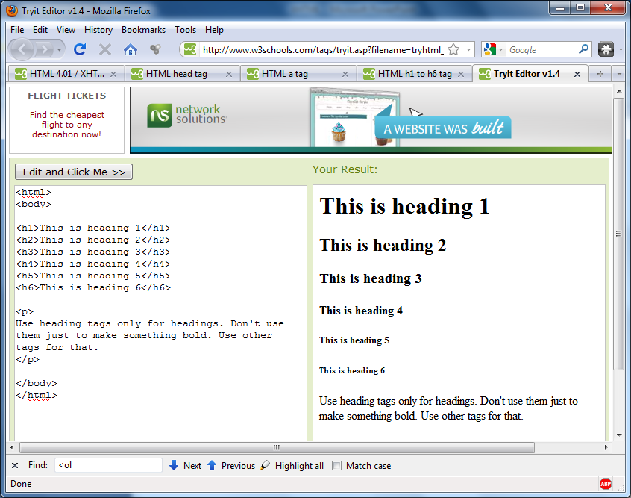

Slide 29
<p> Tag
The <p> tag defines a paragraph.
The p element automatically creates some space before and after itself. The space is automatically applied by the browser, or you can specify it in a style sheet.
<p>This is some text in a paragraph.</p>

Slide 30
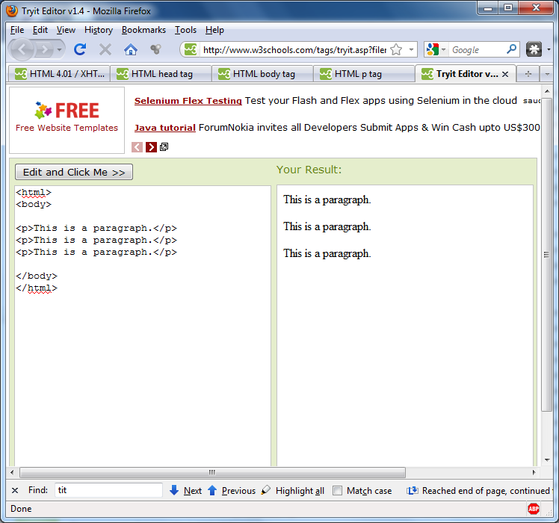

Slide 31
<br /> Tag
The <br /> tag inserts a single line break.
The <br /> tag is an empty tag which means that it has no end tag

Slide 32
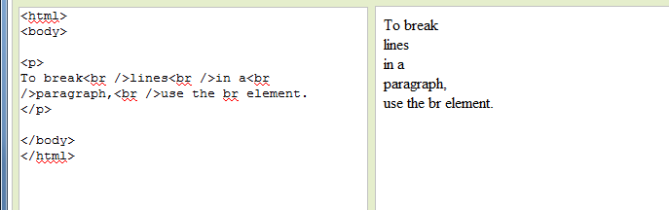

Slide 33
<font> Tag
The <font> tag specifies the font face, font size, and font color of text.
Font tag is deprecated in xhtml and HTML5
<font size="3" color="red">This is some text!</font>
<font size="2" color="blue">This is some text!</font>
<font face="verdana" color="green">This is some text!</font>

Slide 34
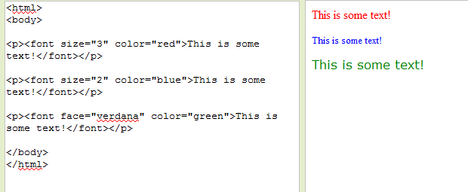
Example

Slide 35
<a> Tag
The <a> tag defines an anchor or hyperlink. An anchor can be used in two ways:
To create a link to another document, by using the href attribute
To create a bookmark inside a document,
<a href="http://www.w3schools.com">Visit W3Schools.com!</a>

Slide 36
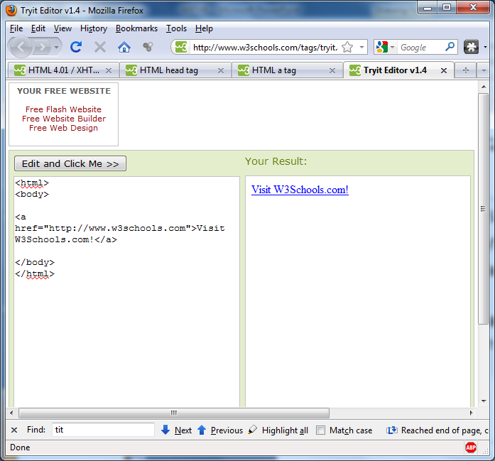

Slide 37
Various text related tag
<b> - bold
<strong>- bold
<i> -italic
<em> - italic
<code>- print text in monotype font
<sub> - subsctipt
<sup>supersctipt

Slide 38
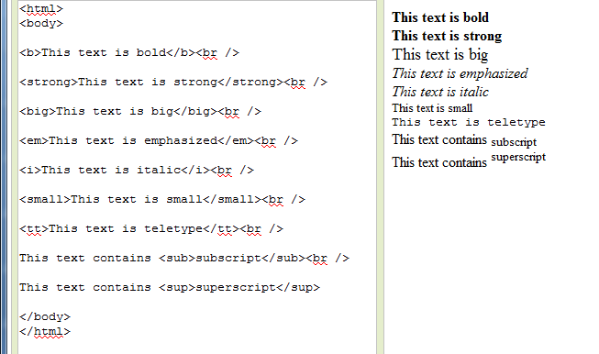
Example

Slide 39
<img> Tag
The <img> tag embeds an image in an HTML page.
Images are not technically inserted into an HTML page, images are linked to HTML pages. The <img> tag creates a holding space for the referenced image.
<img src="w3schools.jpg" width="104" height="142" alt="logo" />

Slide 40
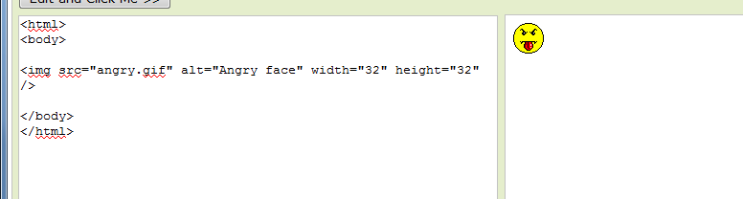
Example

Slide 41
<table> Tag
The <table> tag defines an HTML table.
A simple HTML table consists of the table element and one or more
caption
thead
tfoot
tr,
th, and
td

Slide 42
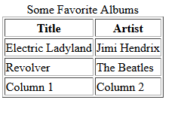
<table> Tag (cont.)
<table border="1">
<caption>
Some Favorite Albums
</caption>
<thead>
<tr>
<th> Title </th>
<th> Artist </th>
</tr>
</thead>
<tfoot>
<tr>
<td> Column 1 </td>
<td> Column 2 </td>
</tr>
</tfoot>
<tbody>
<tr>
<td> Electric Ladyland </td>
<td> Jimi Hendrix </td>
</tr>
<tr>
<td> Revolver </td>
<td> The Beatles </td>
</tr>
</tbody>
</table>
</body>
</html>

Slide 43
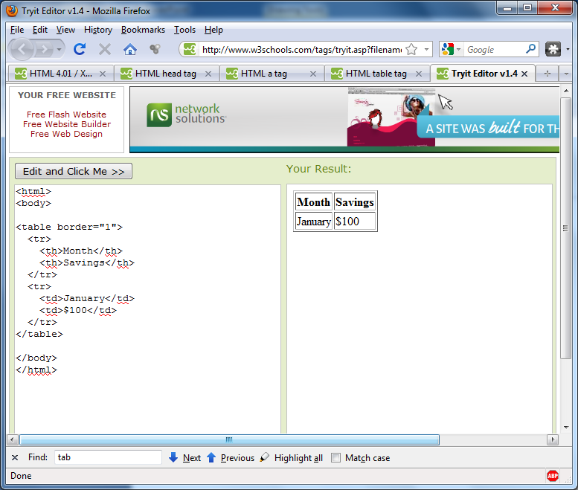

Slide 44
Lists
ul- unordered list
ol- ordered list
dl – definition list

Slide 45
<ul> Tag
The <ul> tag defines an unordered list (a bulleted list).
<ul> <li>Coffee</li> <li>Tea</li> <li>Milk</li> </ul>

Slide 46
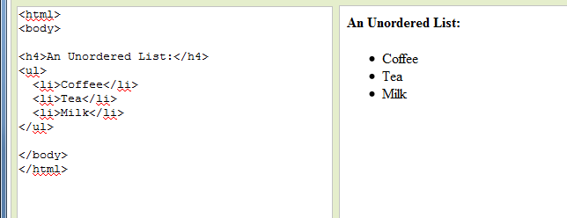

Slide 47
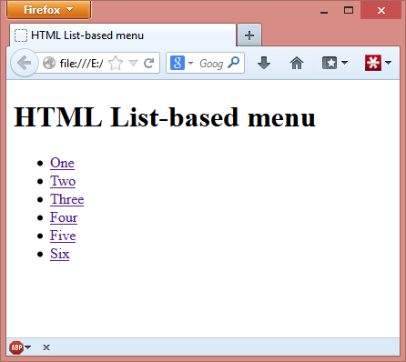
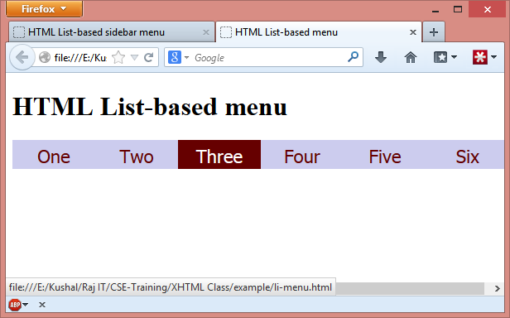
<ul>- as top menu

Slide 48
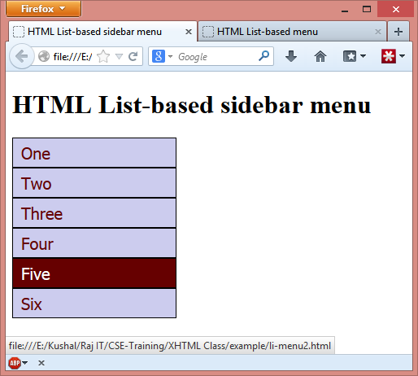
<ul>- as sidrbar menu

Slide 49
<ol> Tag
The <ol> tag is used to create an ordered list.
<ol> <li>Coffee</li> <li>Tea</li> <li>Milk</li> </ol>

Slide 50
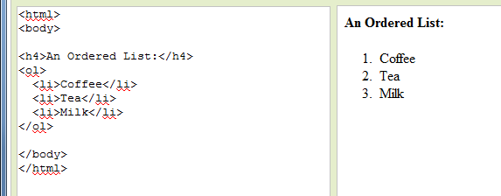

Slide 51
<dl> Tag
The <dl> tag defines a definition list.
The <dl> tag is used in conjunction with <dt> (defines the item in the list) and <dd> (describes the item in the list).
<dl> <dt>Coffee</dt> <dd>- black hot drink</dd> <dt>Milk</dt> <dd>- white cold drink</dd> </dl>

Slide 52
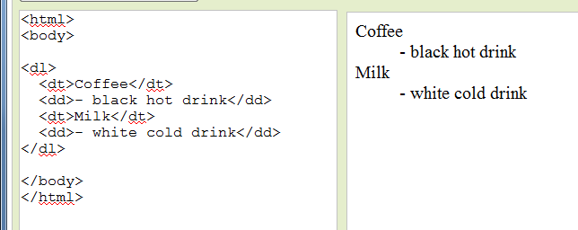

Slide 53
<div> Tag
The <div> tag defines a division or a section in an HTML document.
The <div> tag is often used to group block-elements to format them with styles.
<div style="color:#00FF00"> <h3>This is a header</h3> <p>This is a paragraph.</p> </div>

Slide 54
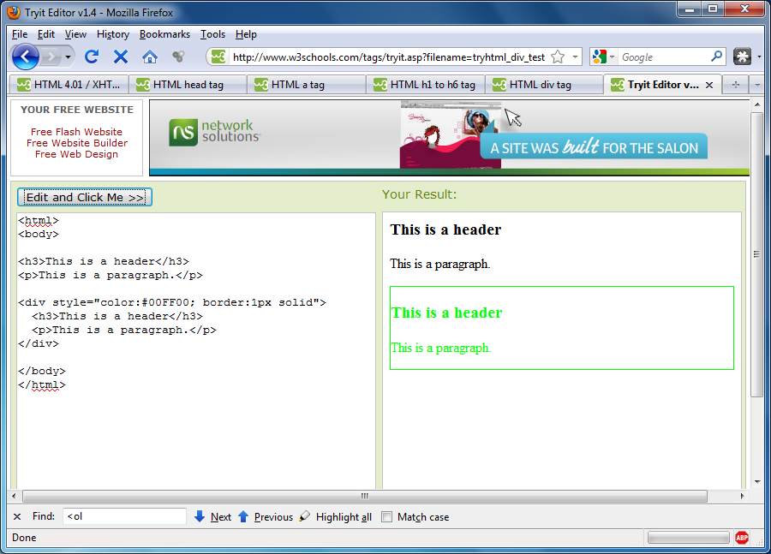
Example

Slide 55
<form> tag
Used to define an html form
<form action=“submit_data.php" method="get >
form elements…….
</form>

Slide 56
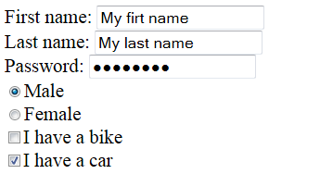
<input /> tag
Used to define an input field
Syntex:
<input type=“text” name=“my_name” value=“my_value” />
Possible type:
- text
- password
- radio
- checkbox

Slide 57

<input>- textbox
<form> First name: <input type="text" name="firstname“ value=“Kushal” /> <br /> Last name: <input type="text" name="lastname" /> </form>

Slide 58

<input>- password
<form> Password: <input type=“password" name=“secret“ value=“abc123#$” /> </form>

Slide 59

<input> - radio
<form> <input type="radio" name="sex" value="male" checked=“checked” /> Male <br /> <input type="radio" name="sex" value="female" /> Female </form>

Slide 60
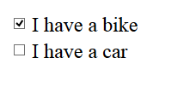
<input> - checkbox
<form>
<input type="checkbox" name="vehicle" value="Bike“ checked=“checked” /> I have a bike
<br />
<input type="checkbox" name="vehicle" value="Car" />I have a car
</form>

Slide 61
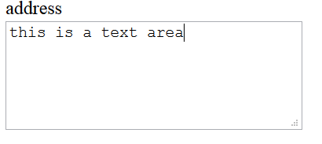
<textarea> tag
Used to create a multiline textbox
<textarea rows="5" cols="30“ name=“address”>
this is a text area
</textarea>

Slide 62
<select> tag
Use 1
Used to create a dropdown or multi select listbox
Syntex:
<select name=“name of the control" >
<option value=“opt value"> opt label </option>
.
.
.
<option value=“opt value n"> opt label n </option>
</select>

Slide 63
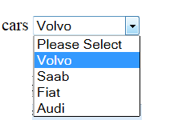
<select> tag
Use 1
Used to create a dropdown combobox
Syntex:
<select name="cars" >
<option value="-1">Please Select</option>
<option value="volvo">Volvo</option>
<option value="saab">Saab</option>
<option value="fiat">Fiat</option>
<option value="audi">Audi</option>
</select>

Slide 64
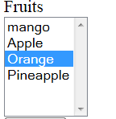
<select> tag
Use 2
Used to create a list
Syntex:
<select name="fruits" size="6" >
<option value="mango">mango</option>
<option value="Apple">Apple</option>
<option value="orange">Orange</option>
<option value="pineapple">Pineapple</option>
</select>

Slide 65
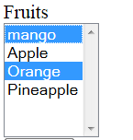
<select> tag
Use 3
Used to create a multi-select list
Syntex:
<select name="fruits" size="6“ multiple="multiple" >
<option value="mango">mango</option>
<option value="Apple">Apple</option>
<option value="orange">Orange</option>
<option value="pineapple">Pineapple</option>
</select>

Slide 66
<submit /> tag
Used to create a button that will send form data to server when clicked
Syntax:
<input type="submit" value="Send Data" />

Slide 67

Forms Element- submit
<form action="form_submit.php" method="get"> Username: <input type="text" name="user" /> <input type="submit" value="Submit" /> </form>

Slide 68


HTML Forms
<form> <input type="radio" name="sex" value="male" /> Male <br /> <input type="radio" name="sex" value="female" /> Female </form>
<form> First name: <input type="text" name="firstname" /> <br /> Last name: <input type="text" name="lastname" /> </form>
<form name="input" action="html_form_submit.asp" method="get"> Username: <input type="text" name="user" /> <input type="submit" value="Submit" /> </form>

Slide 69
HTML form
Example

Slide 70
<head> Tag
The head element is a container for all the head elements. Elements inside <head> can include scripts, instruct the browser where to find style sheets, provide meta information, and more.
The following tags can be added to the head section:
<link>,
<meta>,
<script>
<style>
<title>

Slide 71
<style> Tag
The <style> tag is used to define style information for an HTML document
<html> <head> <style type="text/css">
h1 { color:red; }
p { color:blue; font-size:”12px”}
</style> </head> <body> <h1>Header 1</h1> <p>A paragraph.</p> </body> </html>

Slide 72
<link> Tag
The <link> tag defines the relationship between a document and an external resource.
The <link> tag is most used to link to style sheets.
<head> <link rel="stylesheet" type="text/css" href="theme.css" />
</head>
theme.css
Web page

Slide 73
<script> Tag
The <script> tag is used to define a client-side script, such as a JavaScript.
<script type="text/javascript"> document.write("Hello World!")
</script>
<script src=“xyz.js” type="text/javascript"> </script>
xyz.js

Slide 74
<meta> Tag
The <meta> tag provides meta data about the HTML document.
Metadata will not be displayed on the page, but it will be used by search engines to index the page in proper category.
Each meta tag has two attributes
name : represents the name of a metadata
content : represents the value of the metadata

Slide 75
<meta> Tag
<head> <meta name="description" content="Free Web tutorials" /> <meta name="keywords" content="HTML,CSS,XML,JavaScript" /> <meta name="author" content=“Kushal" /> <meta http-equiv="Content-Type" content="text/html; charset=utf-8" /> </head>
http-equiv attribute allows the document author to insert HTTP header information.
The browser can access this information during read time.

Slide 76
http-equiv
<meta http-equiv=”content-type” content=”charset=charset” />
Sets the character set for the page
<meta http-equiv=”expires” content=”date” />
the document will be reloaded after the date is expires.
<meta http-equiv="Cache-Control" content="no-cache" />
Used to prevent page caching
<meta http-equiv=“refresh" content="2” />
Used to refresh a page automatically
<meta http-equiv=“content-encoding” content=”gzip” />
Server sends the page to browser in compressed format

Slide 77
<title> Tag
The <title> tag defines the title of the document.
The title element is required in all HTML/XHTML documents.
<html> <head> <title>Title of the document</title> </head>
<body> The content of the document...... </body> </html>

Slide 78
Differences Between XHTML And HTML
XHTML Elements Must Be Properly Nested
In HTML, some elements can be improperly nested within each other, like this:
<b><i>This text is bold and italic</b></i>
In XHTML, all elements must be properly nested within each other, like this:
<b><i>This text is bold and italic</i></b>

Slide 79
Differences Between XHTML And HTML
XHTML Elements Must Always Be Closed
This is wrong:
<p>This is a paragraph <p>This is another paragraph
This is correct:
<p>This is a paragraph</p> <p>This is another paragraph</p>

Slide 80
Differences Between XHTML And HTML
Empty Elements Must Be Closed
This is wrong:
A break: <br> A horizontal rule: <hr> An image: <img src="happy.gif" alt="Happy face">
This is correct:
A break: <br /> A horizontal rule: <hr /> An image: <img src="happy.gif" alt="Happy face" />

Slide 81
Differences Between XHTML And HTML
XHTML Elements Must Be In Lower Case
This is wrong:
<BODY> <P>This is a paragraph</P> </BODY>
This is correct:
<body> <p>This is a paragraph</p> </body>

Slide 82
Differences Between XHTML And HTML
Some More XHTML Syntax Rules
Attribute names must be in lower case
Attribute values must be quoted
The id attribute replaces the name attribute
The XHTML DTD defines mandatory elements

Slide 83
Some advanced topic

Slide 84
HTML Attributes
HTML elements can have attributes
Attributes provide additional information about an element
Attributes are always specified in the start tag
Attributes come in name/value pairs like: name="value”
Value may be string or numeric
Some elements don’t have attributes ( <br />)

Slide 85
HTML Standard Attributes
Core Attributes (name, class, id, style, title etc)
Language Attributes (lang, dir etc)
Keyboard Attributes (accesskey, tabindex etc)
Event Attributes
Form Events (onblur, onfocus etc)
Keyboard Events (onkeydown, onkeypress etc…)
Mouse Events (onclick, ondblclick etc…)

Slide 86
Core Attributes
Common attributes are applied to all the HTML elements
id
a unique identifier for this element in the document
class
classifies this element into one or more subtypes
lang
specifies the language of this element’s content along with the language of any attribute content (for example, that inside the title attribute)

Slide 87
Core Attributes
dir
specifies the reading direction for text as left to right (ltr) or right to left (rtl)
style
specifies an inline style for this element
title
provides extra information about the element
xml:lang
specifies the language of the content inside this element in XHTML documents

Slide 88
Event Attributes
attributes that is used to capture an event, and trigger an action with a client-side scripting language such as JavaScript
onblur captures the moment that this element loses focus
onchange captures the moment when the value of this element is changed
onclick captures a mouse click on the element
ondblclick captures a double mouse click on this element
onfocus captures the moment that this element receives focus, either via the cursor or keyboard navigation

Slide 89
Event Attributes
attributes that is used to capture an event, and trigger an action with a client-side scripting language such as JavaScript
onkeydown captures the event in which a key pressed down (but not released) while focus is on the element
onkeypress captures a key press while focus is on this element
onkeyup captures the moment at which a pressed key is released while focus is on the element
onload catches the point at which a page has completely loaded
onmousedown captures the pressing down of the mouse button while the cursor is positioned over the element
onmousemove captures a mouse movement within this element
onmouseout captures the movement of a cursor off an area covered by this element

Slide 90
Event Attributes
attributes that is used to capture an event, and trigger an action with a client-side scripting language such as JavaScript
onmouseover captures the movement of a cursor into an area covered by this element
onmouseup captures the release of a previously pressed mouse button while the cursor is over the element
onreset captures the moment that this form’s Reset button is activated
onselect captures the event in which the user selects, or highlights, text in the element
onsubmit captures the moment that the form element to which this attribute is applied is submitted
onunload catches the point at which a page has unloaded

Slide 91
Thank you

